Slide 1

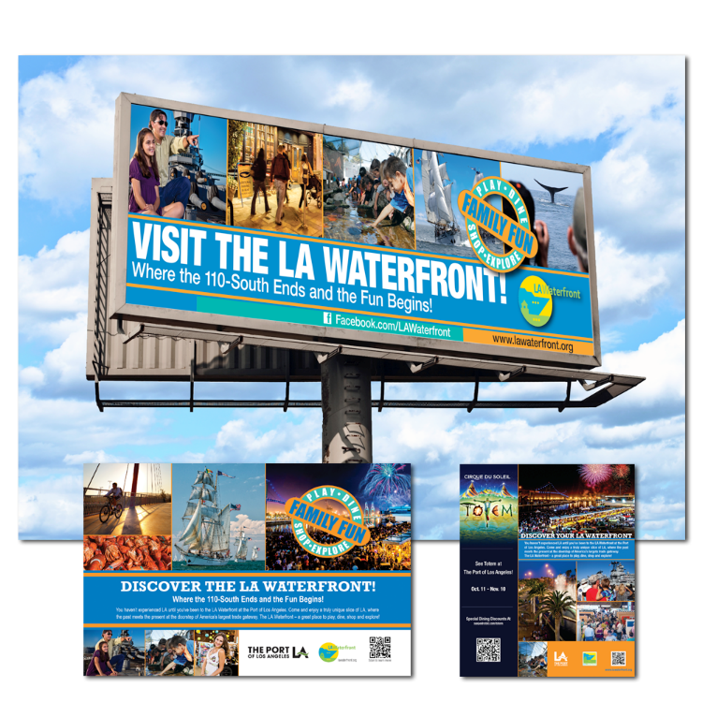
Port of
Los Angeles
LA Waterfront
Summer Ad Campaign
Advertisements - Series

